Slide 1
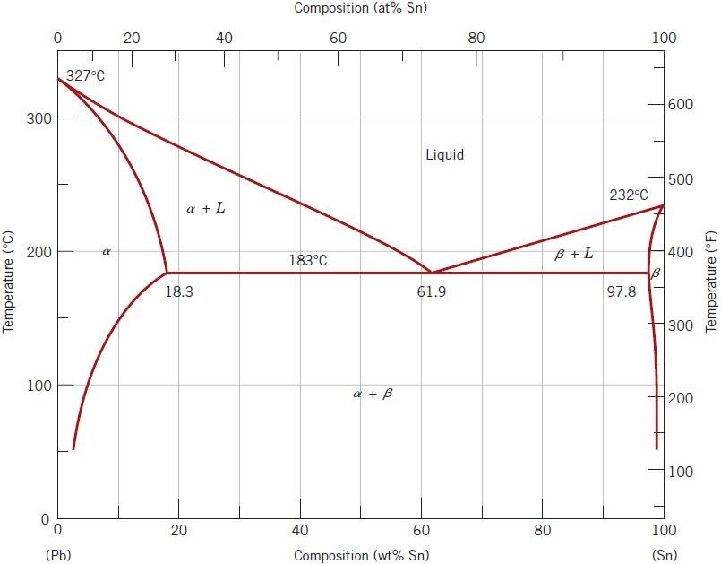
Figure 6 lead–tin phase diagram.
Development of Microstructure in Eutectic Alloys
Depending on composition, several different types of microstructures are possible
for the slow cooling of alloys belonging to binary eutectic systems. These possibilities will be considered in terms of the lead–tin phase diagram, Figure 6.
The first case is for compositions ranging between a pure component and the
maximum solid solubility for that component at room temperature [20°C]. For the lead–tin system, this includes lead-rich alloys containing between 0 and about 2
1

Slide 2
wt% Sn (for the α-phase solid solution) and also between approximately 99 wt%
Sn and pure tin (for the β phase). For For example, consider an alloy of
composition C₁ (Figure 7) as it is slowly cooled from a temperature within the
liquid-phase region, say, 350°C; this corresponds to moving down the dashed
vertical line ww´ in the figure. The alloy remains totally liquid and of composition
C₁ until we cross the liquidus line at approximately 330°C, at which time the solid
α phase begins to form. While passing through this narrow α+L phase region,
solidification proceeds in the same manner as was described for the copper–nickel
alloy; that is, with continued cooling, more of the solid α forms. Furthermore,
liquid- and solid-phase compositions are different, which follow along the liquidus
and solidus phase boundaries, respectively. Solidification reaches completion at the
point where ww´ crosses the solidus line. The resulting alloy is polycrystalline with
a uniform composition of C₁, and no subsequent changes will occur upon cooling
to room temperature. This microstructure is represented schematically by the inset
at point c in Figure 7.
2

Slide 3
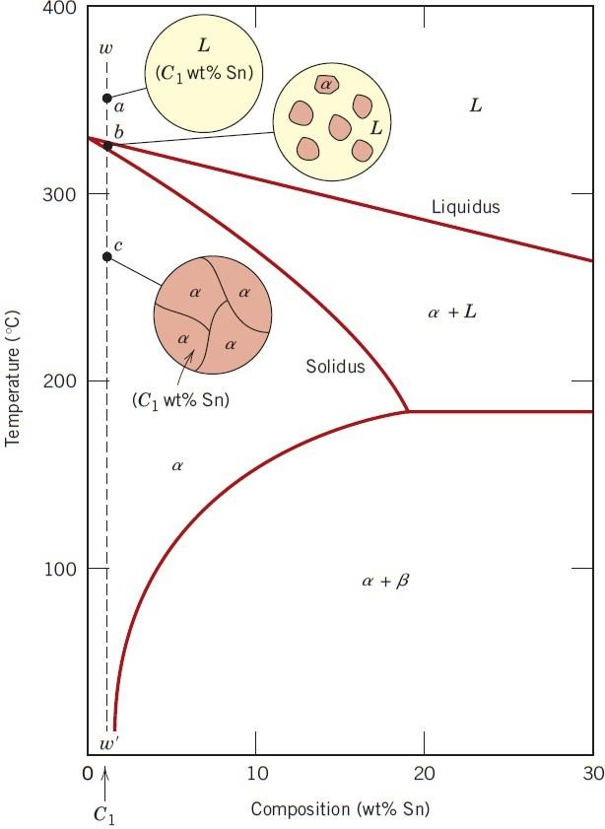

Figure 7 Schematic representations of the equilibrium microstructures for a lead–tin alloy of composition
C₁ as it is cooled from the liquid- phase region.
The second case considered is for compositions that range between the room
temperature solubility limit and the maximum solid solubility at the eutectic
temperature. For the lead–tin system, these compositions extend from about 2 to
18.3 wt% Sn (for lead-rich alloys) and from 97.8 to approximately 99 wt% Sn (for
tin-rich alloys). Let us examine an alloy of composition C₂ as it is cooled along the
vertical line xx´ in Figure 8. Down to the intersection of xx´ and the solvus line,
changes that occur are similar to the previous case as we pass through the
corresponding phase regions (as demonstrated by the insets at points d, e, and f ).
Just above the solvus intersection, point f, the microstructure consists of α grains of
composition C₂. Upon crossing the solvus line, the α solid solubility is exceeded,
3

Slide 4
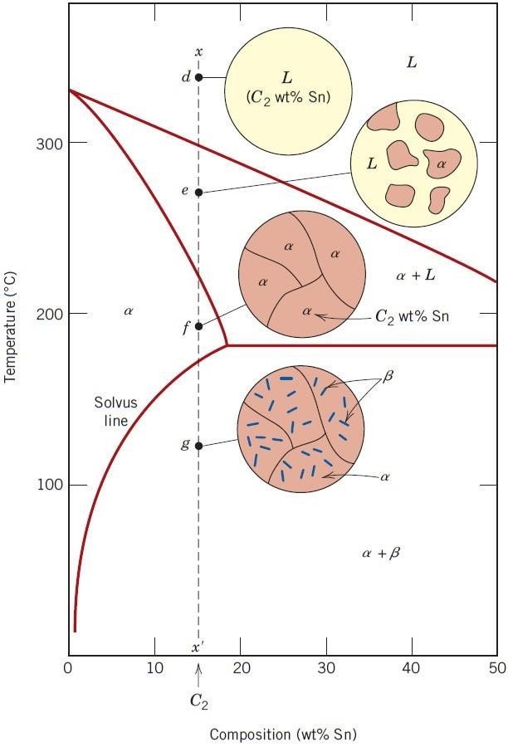

which results in the formation of small β-phase particles; these are indicated in the
microstructure inset at point g. With continued cooling, these particles will grow in
size because
temperature.
the
mass
fraction
of
the
β
phase
increases
slightly
with
decreasing
Figure 8 Schematic representations of the equilibrium microstructures for a lead–tin alloy of composition C₂ as it is cooled from the liquid-
phase region.
The third case involves solidification of the eutectic composition, 61.9 wt% Sn (C3
in Figure 9). Consider an alloy having this composition that is cooled from a
temperature within the liquid-phase region (e.g., 250° C) down the vertical line yy´
in Figure 9. As the temperature is lowered, no changes occur until we reach the
eutectic temperature, 183°C. Upon crossing the eutectic isotherm, the liquid
4

Slide 5
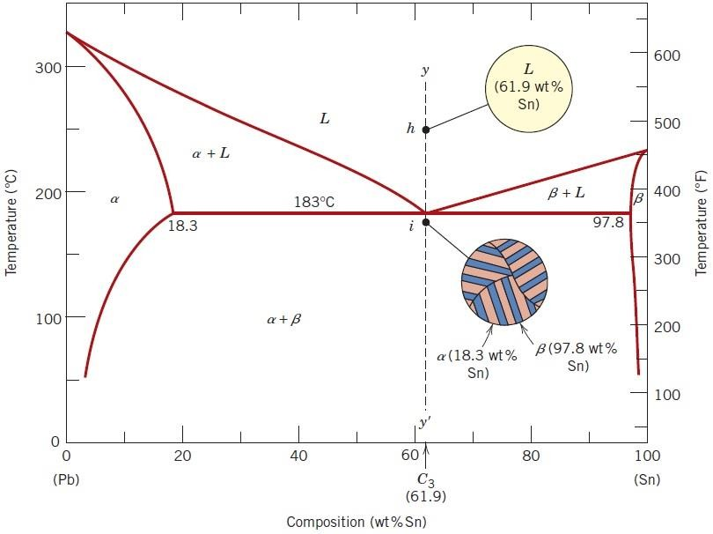
transforms into the two α and β phases. This transformation may be represented by
the reaction
in which the α- and β-phase compositions are dictated by the eutectic isotherm end
points.
Figure 9 Schematic representations of the equilibrium microstructures for a lead–tin alloy of eutectic composition C₃ above and below the eutectic temperature.
During
this transformation, there must be a redistribution of the lead and tin
components because the α and β phases have different compositions, neither of
which is the same as that of the liquid (as indicated in the above reaction).This redistribution is accomplished by atomic diffusion. The microstructure of the solid
5

Slide 6
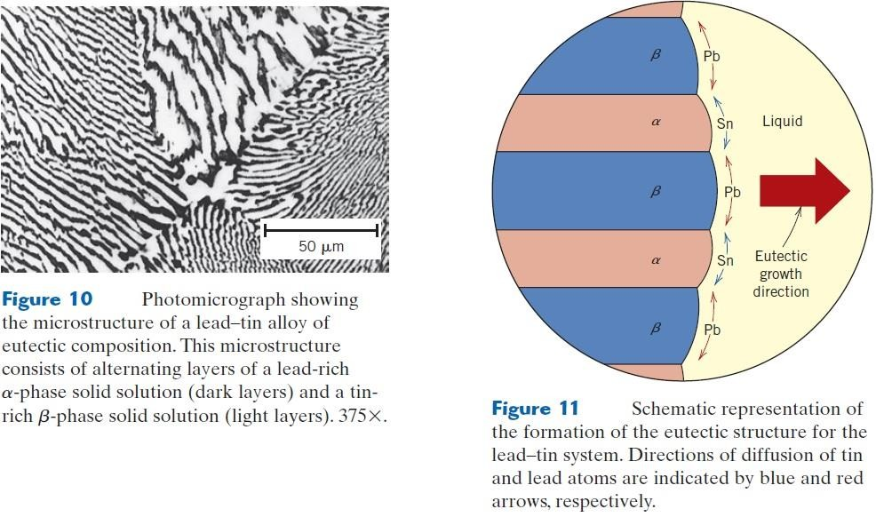
that results from this transformation consists of alternating layers (sometimes
called lamellae) of the α and β phases that form simultaneously during the
transformation. This microstructure, represented schematically in Figure 9, in point
(i), is called a eutectic structure and is characteristic of this reaction. A
photomicrograph of this structure for the lead–tin eutectic is shown in Figure 10.
Subsequent cooling of the alloy from just below the eutectic to room temperature
will result in only minor microstructural alterations.
The microstructural change that accompanies this
eutectic transformation is
represented schematically in Figure 11, which shows the α-β layered eutectic
growing into and replacing the liquid phase. The process of the redistribution of
lead and tin occurs by diffusion in the liquid just ahead of the eutectic–liquid
interface. The arrows indicate the directions of diffusion of lead and tin atoms; lead
atoms diffuse toward the α-phase layers because this α phase is lead rich (18.3 wt%
6

Slide 7
Sn–81.7 wt% Pb); conversely, the direction of diffusion of tin is in the direction of
the β, tin-rich (97.8 wt% Sn–2.2 wt% Pb) layers. The eutectic structure forms in
these alternating layers because, for this lamellar configuration, atomic diffusion of
lead and tin need occur over only relatively short distances.
The fourth and final microstructural case for this system includes all compositions
other than the eutectic that, when cooled, cross the eutectic isotherm. Consider, for
example, the composition C₄ in Figure 12, which lies to the left of the eutectic; as
the temperature is lowered, we move down the line zz´, beginning at point j. The
microstructural development between points j and l is similar to that for the second
case, such that just prior to crossing the eutectic isotherm (point l), the α and liquid
phases are present with compositions of approximately 18.3 and 61.9 wt% Sn,
respectively, as determined from the appropriate tie line. As the temperature is
lowered to just below the eutectic, the liquid phase, which is of the eutectic
composition, will transform into the eutectic structure (i.e., alternating α and β
lamellae); insignificant changes will occur with the α phase that formed during
cooling through the α+L region. This microstructure is represented schematically
by the inset at point m in Figure 12. Thus, the α phase will be present both in the
eutectic structure and also as the phase that formed while cooling through the α+L
phase field. To distinguish one α from the other, that which resides in the eutectic
structure is called eutectic α, whereas the other that formed prior to crossing the
eutectic isotherm is termed primary α; both are labeled in Figure 12.The
photomicrograph in Figure 13 is of a lead–tin alloy in which both primary α and
eutectic structures are shown.
7

